Slide 1
Image Segmentation and Data Extraction Pipeline
-Presented by- Mayuri Sarda

Slide 2
Approach overview
Image Segmentation:
Use the Detectron2 framework for instance segmentation.
Load a pre-trained Mask R-CNN model from the model zoo.
Perform segmentation to identify objects within the image.
Object Identification and Text Extraction:
Utilize EasyOCR for optical character recognition (OCR) to extract text from segmented objects.
Use BLIP (Bootstrapping Language-Image Pretraining) for generating descriptions of the objects.

Slide 3
Approach overview
Data Mapping and Storage:
Extract and store data (object type, detected text, descriptions) in an SQLite database.
Create a JSON file for structured data mapping.
Visualization and Output Generation:
Generate annotated images and tabular data for segmented objects.
Display final output and data in a user-friendly format.

Slide 4
Implementation steps
1. Setup and Preprocessing:
Install necessary libraries and frameworks (Detectron2, EasyOCR, BLIP).
Load and display the original input image.
2. Image Segmentation:
Configure and load the Mask R-CNN model.
Perform instance segmentation on the input image.

Slide 5
Implementation steps
3. Text and Description Extraction:
Extract text from segmented objects using EasyOCR.
Generate descriptions using the BLIP model.
4. Data Storage and Mapping:
Store extracted data in an SQLite database.
Create a JSON file for structured data mapping.
5.Visualization:
Annotate the original image with segmentation results.
Display data in a tabular format.

Slide 6
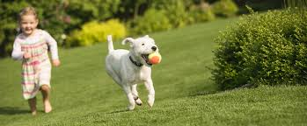
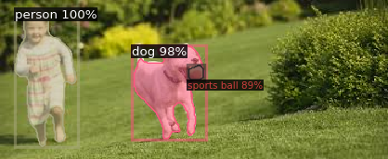
Input image and segmented image

Slide 7
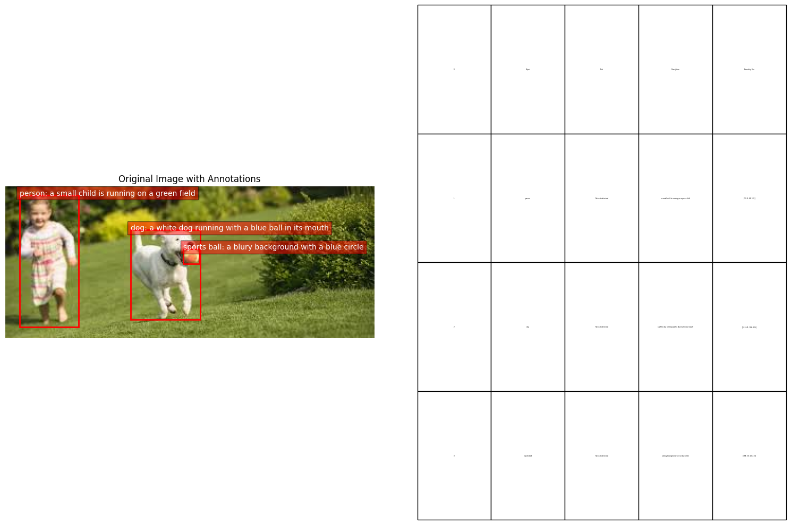
Output image

Slide 8
Challenges and solution
Libraries and Model Installations:
Challenge: Ensuring compatibility between various libraries and model versions can be tricky, especially with frameworks like Detectron2 and Torch, which have specific dependency requirements.
Large and Complex Images:
Challenge: Processing large and complex images can be resource-intensive, leading to slow performance or memory issues.
Handling Corrupted Models:
Challenge: Encountering truncated or corrupted model files can halt the progress of your project.

Slide 9
Challenges and solution
Text Extraction Accuracy:
Challenge: Achieving high accuracy in text extraction, especially from images with varying quality and text orientations.
Integration of Multiple Models:
Challenge: Integrating multiple models (e.g., segmentation, text extraction, description generation) into a seamless pipeline can be complex.

Slide 10
Thank you

